Slide 1

SEMI-CENTRALIZED PROMOTIONS
76th Operational response command
12 SEP 2023

Slide 2


Army Reserve TPU Semi-Centralized Process
1st of Month
12th thru 30th
1st of Next Mo.
2nd of Month
PCR populates all eligible Soldiers – Co CDRs make recommendation for consideration
Enters Board results / Promo Authority Approves Results
IPPS-A refreshes the PCR, and moves promotion selects to the PRR
PAM (within Talent Management Module) pulls PRR data
Step 1
Step 2
Step 3
Step 4
Promotion Points are auto-calculated and auto- updated throughout this period
Unit conducts promotion board
Promotion Points are “frozen” when PAM runs. Point updates resume the following day on a daily basis.
3rd thru 20th
21st of Month
22nd of Month
1st of Next Mo.
PAM matches and slates Soldiers to position of higher grade if pin-on eligible
Slate completed; reassignment orders published with future effective date
Board roster populated with promotion effective dates (same as reassignment date)
Nightly Promotion batch process runs eligibility and promotes Soldiers
Step 5
Step 6
Step 7
Step 8
PAM runs o/a 5th of each month (based on slating calendar)
RD disseminates slotting report to MSCs o/a 6th of the month
MSCs submit discrepancies (if any) by the 20th of the month
Promotion point updates resume on the PRR for subsequent month selections
*PCR= Promotion Consideration Roster
*PRR= Promotion Recommended Roster
*PAM= Promotion Assignment Match

Slide 3
Semi-Centralized Promotion Process
Promotion Recommended Roster Integration Process
_{1st– 11th day of each Month}
_{12th thru 30th}
_{1st day of Next Month}
PCR populates all eligible Soldiers on 1st day of each month. Unit Commander makes recommendation for board consideration by the 11th day of the month.
Human Resource Professional enters board results on the PCR. Promotion Authority certifies (approves) board results.
IPPS-A refreshes the PCR and moves promotion selects to the PRR.
Step 1
Step 2
Step 3
Unit conducts promotion board outside IPPS-A (can be conducted any time during the month)
Promotion points are auto-calculated and auto- updated throughout this period
Promotion Points are “frozen” when PAM runs. Promotion point updates resume the following day and continues daily.
*PCR= Promotion Consideration Roster
*PRR= Promotion Recommended Roster

Slide 4
PRR Integration Process:
Step 1 Details
Step 1 (1st - 11th day of the month):
Promotion Consideration Roster (PCR) generates on the first day of each month.
Company Commander makes election* for each eligible Soldier on the PCR. Options:
  Recommend for Consideration (Y)
  Withhold from Consideration (N)
Company Commander’s PCR roster example on the next slide.
Board may be conducted at any time of the month.
*Note: if Company Commander fails to elect recommendation, Soldier may be considered by the promotion board (see policy)

Slide 5
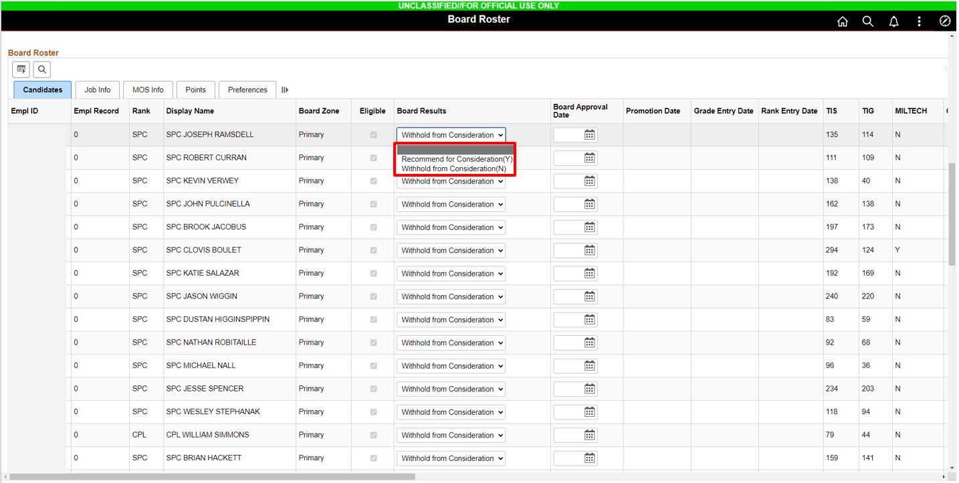
Company Commander’s recommendation on PCR

Slide 6
PRR Integration Process:
Step 2 Details
STEP 2 (12TH – 30TH DAY OF THE MONTH):
Units conduct junior promotion boards (Outside IPPS-A, may be done at any time of the month).
  Battalion (or appropriate level) echelon may conduct virtual boards.
  *Battalion (or appropriate level) CSM may provide direct promotion recommendation to the promotion authority for integration onto the PRR.
  This exception may be used in lieu of a junior promotion board at this time.
Human Resource (HR) Professional submits board results (Promotion Select / Promotion Non-Select) onto the PCR and notifies the promotion authority.
Promotion authority reviews and approves PCR in IPPS-A.
If promotion authority does not certify the PCR in IPPS-A by end of convening board month, Soldiers will NOT be integrated onto the PRR.
Post board PCR example roster is on the next slide.

Slide 7
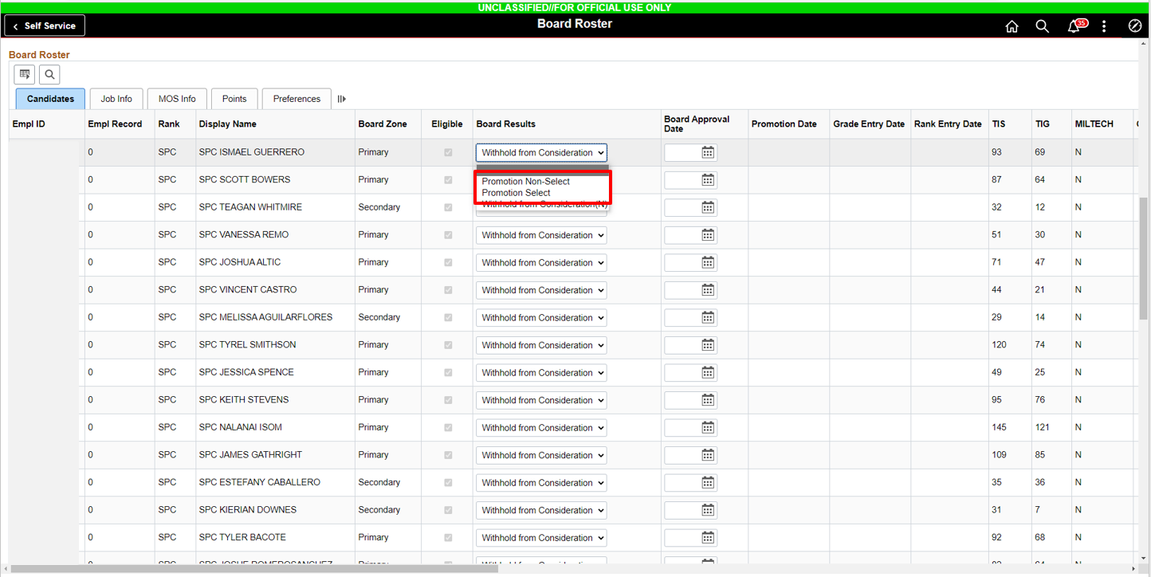
Post-Board PCR Example
Soldiers recommended for promotion are marked as “Promotion Select”
Soldiers not recommended will be marked as “Promotion Non-Select”

Slide 8
Mandatory List Integration (MLI)
Command List Integration (CLI) now MLI, will integrate Soldiers onto the PRR when they meet the established Time in Grade (TIG) and Time in Service (TIS) requirements.
IAW Office of the Chief Army Reserve, DAAR-HR memorandum, dated 21 Aug 21, MLI will only integrate aspiring SSGs onto the PRR. Integration for aspiring SGTs is rescinded.
MLI aspiring SSG requirements (based on Pin-On criteria):
  TIG: 24 months
  TIS: 84 months
Soldiers who meet MLI eligibility criteria will default to MLI and “Promotion Select”
MLI PCR example on the next slide.

Slide 9
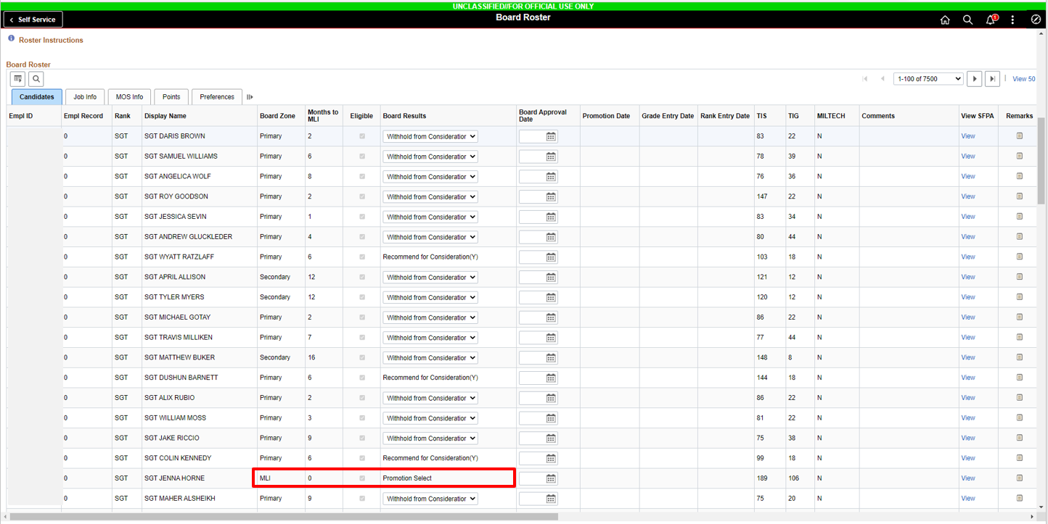
MLI Soldier on PCR example

Slide 10
PRR Integration Process:
Step 3 Details
STEP 3 (1ST DAY OF 2ND MONTH):
During Step 3, IPPS-A refreshes the Promotion Consideration Roster and integrates all Soldiers recommended (Promotion Selects) to the Promotion Recommended Roster.
IPPS-A generates new Promotion Consideration Roster. Soldiers not recommended for promotion on previous board will appear on newly generated PCR.

Slide 11
Semi-Centralized Promotion Process (Cont.)
SLATING AND PROMOTION PROCESS
3rd - 20th day of each month
21st day of Month
22nd day of Month
1st day of 3rd Month
PAM matches and slates Soldiers to position of higher grade if pin-on eligible. System will slate based on available vacancies within the Soldier’s elected mileage.
Slate completed. IPPS-A generates reassignment orders with future effective date (40-45 days out).
IPPS-A Slotting roster populates with promotion effective dates. Promotion effective date will be the same as reassignment date.
Nightly Promotion batch process runs eligibility and promotes Soldiers.
Step 2
Step 3
Step 4
Step 1
PAM runs o/a 5th of each month (based on slating calendar)
RD disseminates slotting report to MSCs o/a 6th of the month
MSCs submit discrepancies (if any) by the 20th of the month
Example: PAM runs in the month of January (Jan).
5 Jan: PAM matches and slates Soldiers
21 Jan: Slate Completed in IPPS-A
22 Jan: Reassignment orders generated with 1 March effective date
1 Mar: Promotion orders generated after reassignment is effective
*PAM= Promotion Assignment Match (promotion slate)
Notes:
- Failure to report to the position identified within the required timeframe will result in revocation of promotion orders and recoupment of all pay and allowances accrued at the higher pay grade

Slide 12
Slating & Promotion Process:
Step 1 Details
STEP 1 (3RD – 20TH DAY OF MONTH):
PAM (slate) runs and matches Soldiers to Job Openings (vacancies) (One-day process).
Readiness Divisions (RD) review and disseminate slotting reports with suspense date to MSCs to identify any discrepancies.
During this timeframe, RDs will move Soldiers slotted against an MOS/Grade mismatch position on the Human Resource Authorization Report to a standard excess templet.
MSCs provide any discrepancies identified on slotting report by suspense date.
Notes:
- Vacancy Unit Review and Eligible: Select Grade of the vacancies you want to take action on. The blue numbered link under the Encumbered bucket indicates the number of Soldiers that are currently assigned to a valid paragraph, line number and position number for that UIC. The Soldiers assigned to these positions might not be a Grade or MOS match to the vacancy requirements. As the Unit Promotion Manager, you will need to decide whether or not to delete this vacancy from consideration for a promotion opportunity. The blue numbered link under the Other bucket indicates the number of valid paragraph, line number and position numbered vacancies that currently are classified as “Open” or “Unassigned” positions. You need to decide whether or not to delete this vacancy from consideration for a promotion opportunity.
- Vacancy management module is fully automated and driven by criteria established in regulatory guidance and command policy

Slide 13
Slating & Promotion Process: Steps 2-4 Details
STEP 2 (21ST DAY OF MONTH)
RDs will complete PAM review and slate is finalized.
IPPS-A publishes reassignment orders with future effective date (typically about 40-45 days out).
Step 3 (22nd day of month)
System updates promotion effective date on board roster. The promotion effective date will align with reassignment effective date.
Step 4 (1st day of 3rd month)
On the effective date of reassignment, IPPS-A runs a final eligibility check and publishes promotion orders.

Slide 14
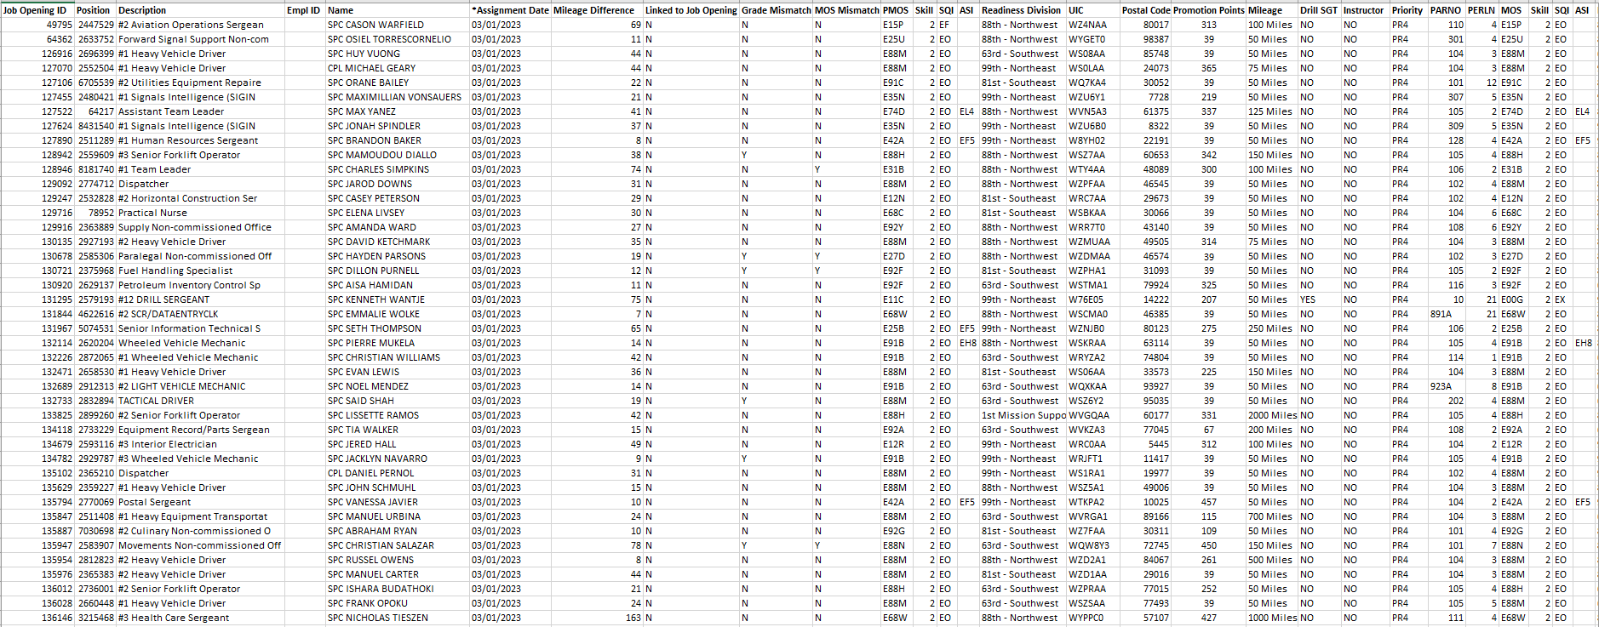
PAM (Slotting Report) Example

Slide 15
Promotion to SGT and SSG
  Semi-centralized process
  Promotion boards at battalion level (COVID-19 ETP waives board requirement)
  Mandatory List Integration for promotion to SSG based on minimum TIG and TIS
  Soldiers who meet promotion eligibility are promoted when matched against a position based on promotion points, MOS, mileage preference
  12-month position obligation with promotion
Notes:
- 1SGs – Soldier needs to be on the PPRL and show in the slating report

Slide 16
E5 and E6 Promotions
Soldier meets TIG/TIS for SGT or SSG
Unit HR professional reviews PCR and notifies Unit Commander (Cdr)
Unit Cdr makes recommendation on PCR by the 11th day of the month
HR Professional prints and provides Promotion Point Worksheet (PPW) to Board members
Promotion Authority (BN) holds promotion board (may be virtual).
**Note, COVID 19 ETP authorizes to skip this step (CSM Input)
Is Soldier Recommended by promotion board
BN Cdr signs PCR in IPPS-A by the end of the convening board month
Soldier is added to PRR
If recommended
If not recommended
First Line Leader counsels Soldier as to why; If eligible, Soldier will be considered by the next Board

Slide 17
How Slating Works
Slating occurs based on the PRR/OML in IPPS-A. IPPS-A generates a numbering system for each Soldier within an MOS. The system then looks at the first Soldier identified within a specific rank and attempts to match them to a position utilizing the slating criteria.
Soldiers aspiring to the ranks of SGT and SSG are given a number based upon their promotion points. The Soldier with the highest number of promotion points receives a higher priority number for slating. Soldiers that have the same number of points are given a slating number based on the earliest DOR. If the DOR is the same, the system then looks at the earliest PEBD, if the PEBD is the same, the system looks at the earliest DOB.

Slide 18
SLATING PROCESS
Any Soldier who is not matched to a vacancy will be returned to the PRR
Are there errors after RD and unit validate Slotting Report?
Is there a valid promotion vacancy within the Soldier’s elected mileage and Slating criteria
Soldiers on the PRR will be matched to valid promotion vacancies IAW Army Reserve policies
Soldier’s name appears on the Slotting Report
YES
NO
Soldier is returned to the PRR
IPPS-A generates reassignment orders with a future effective date. Upon reassignment effective date, IPPS-A generates promotion orders.
Soldier is returned to the PRR

Slide 19
SLATING CALENDAR
Army Reserve Troop Program Unit (TPU) Slating Calendar (IPPS-A Update)
Slating Month | Aspiring Rank |  | Slotting Report Available (o/a) | Reassignment Orders Publish Date (o/a) | Reassignment Effective Date | Promotion Orders Publish Date | Promotion Effective Date
January | MSG/1SG | SSG | 05-Jan | 21-Jan | 01-Mar | 01-Mar | 01-Mar
February | SFC | SGT | 07-Feb | 21-Feb | 01-Apr | 01-Apr | 01-Apr
March | SGM | SSG | 05-Mar | 21-Mar | 01-May | 01-May | 01-May
April | MSG/1SG | SGT | 07-Apr | 21-Apr | 01-Jun | 01-Jun | 01-Jun
May | SFC | SSG | 05-May | 21-May | 01-Jul | 01-Jul | 01-Jul
June | SGM | SGT | 07-Jun | 21-Jun | 01-Aug | 01-Aug | 01-Aug
July | MSG/1SG | SSG | 05-Jul | 21-Jul | 01-Sep | 01-Sep | 01-Sep
August | SFC | SGT | 07-Aug | 21-Aug | 01-Oct | 01-Oct | 01-Oct
September | SGM | SSG | 05-Sep | 21-Sep | 01-Nov | 01-Nov | 01-Nov
October | MSG/1SG | SGT | 07-Oct | 21-Oct | 01-Dec | 01-Dec | 01-Dec
November | SFC | SSG | 05-Nov | 21-Nov | 01-Jan | 01-Jan | 01-Jan
December | SGM | SGT | 07-Dec | 21-Dec | 01-Feb | 01-Feb | 01-Feb
Promotion and reassignment effective date will be 40-45 days from the reassignment order publication date. This time should be used for unit outprocessing and sponsorship with the new unit.
Soldiers must remain fully eligible through entire enlisted promotion cycle to receive promotion orders.
Job Openings (Positions) considered - position without an assigned incumbent, position with an assigned incumbent with a grade mismatch, and position with an assigned incumbent with an MOS mismatch.

